Slide 1
CUSTOM MESSAGING APPLICATION
Custom Messaging Application
Presented By Group 3:
Sasumalli Durga Bhavani
Harshitha Manduri
Chaithra J Shetty
Shireesha Vennapusa
Satrasala Supraja

Slide 2
Contents:
Introduction
Case study
Custom Messaging Architecture
Functionalities
1.Individual Chat
2. Group Chat
3. Send Files
4. Receive files
5. Exiting the application
Valgrind Tool Report
Code Snippet

Slide 3
Introduction
Custom Messaging is an application for messaging between two or more systems.
The messages will be exchanged via client server socket mechanism.
This will enable two systems to talk to each other in real time.

Slide 4
Case study
The application should provide a Custom Messaging feature using client-server connection.
The user will login to the application by giving their username and password.
The server will match the entered username with the users list and if found it will send a message saying that the username already exists.
After successful login, the menu is displayed.
User will be displayed active users list and given the option to select when private chat is selected.
The users can select the required options from the menu and select a person or group from the list and continue to chat.
The user can exit from the application by entering the exit command.

Slide 5
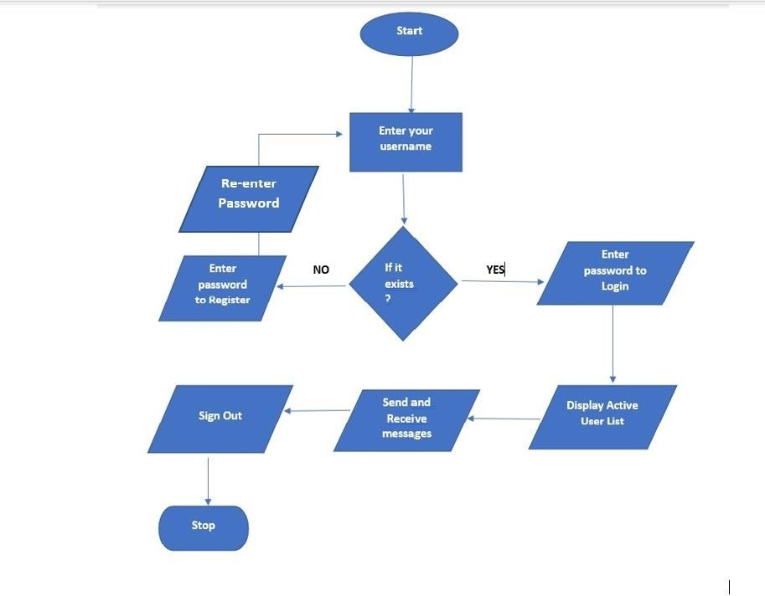
Custom Messaging Application Architecture

Slide 6
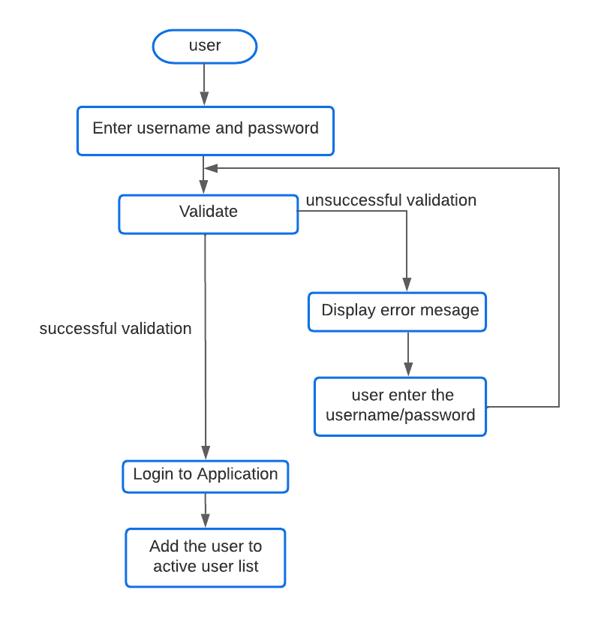
User Login Architecture

Slide 7
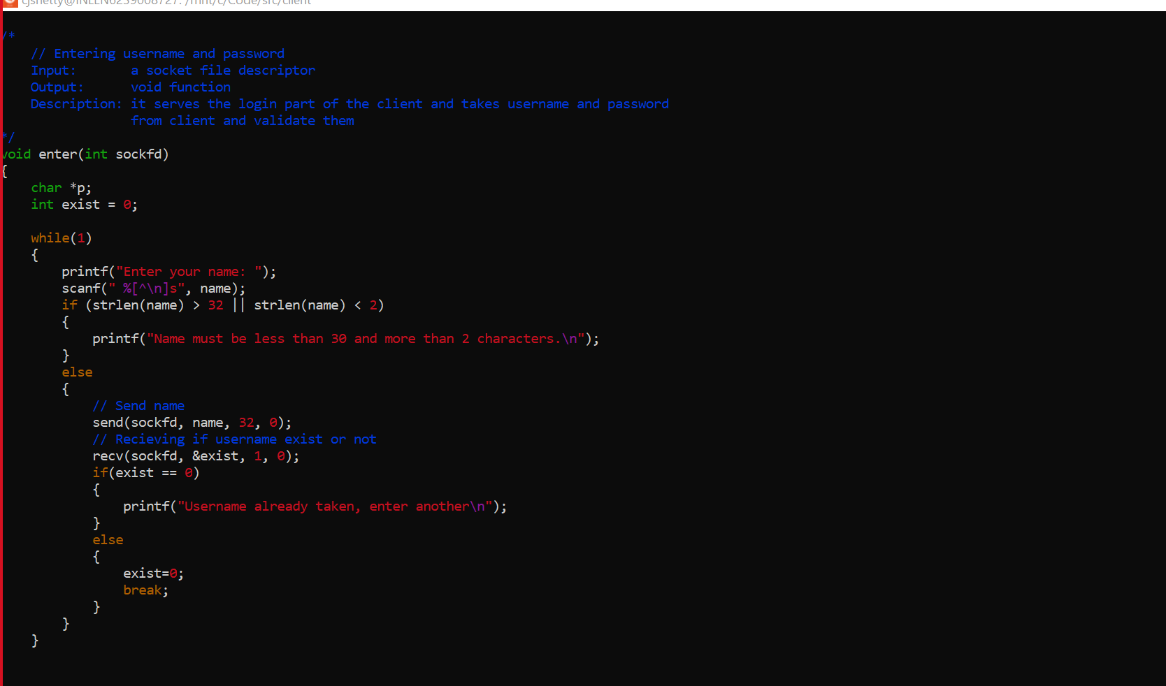
Code Snippet:
Login:

Slide 8
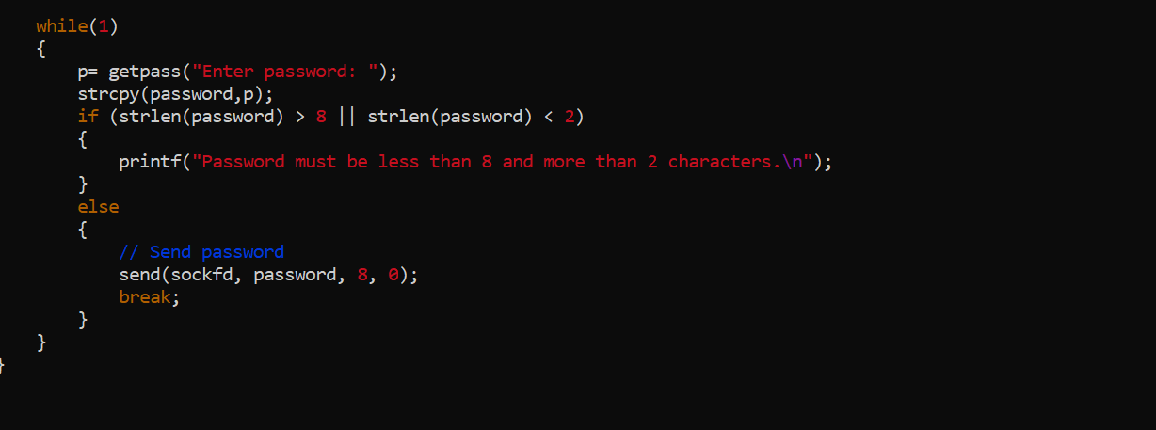

Slide 9
Functionalities
The system interface is developed as a menu driven program with 4 choices
Private Chat
Group Chat
Send File
Receive File
Exit from Application

Slide 10
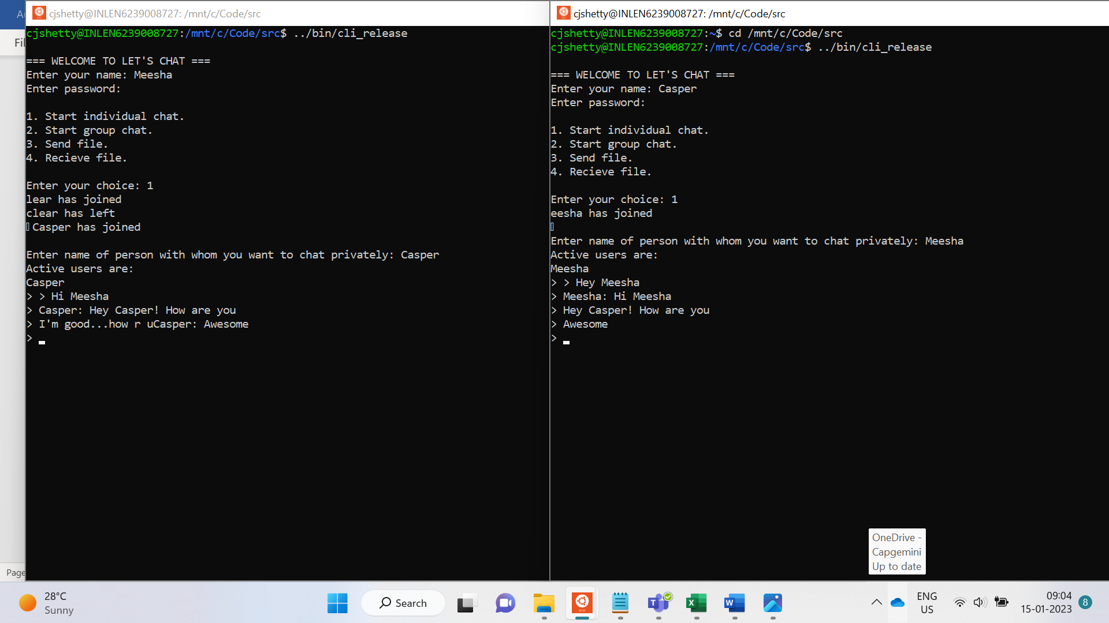
Individual Chat

Slide 11
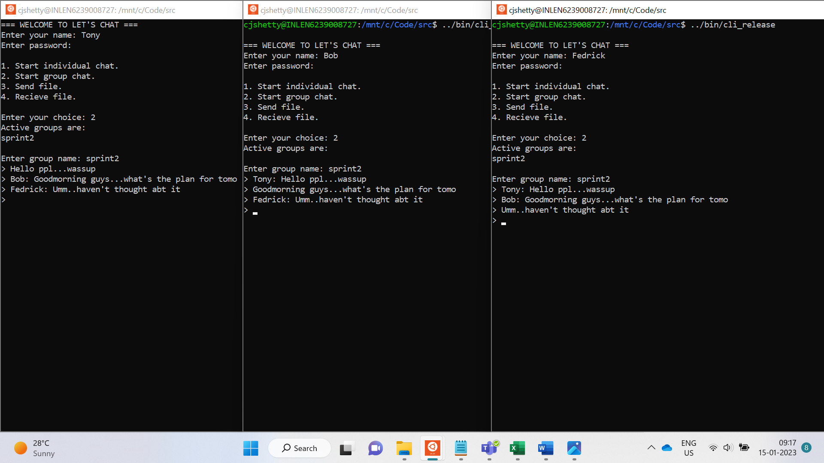
2. Group Chat

Slide 12
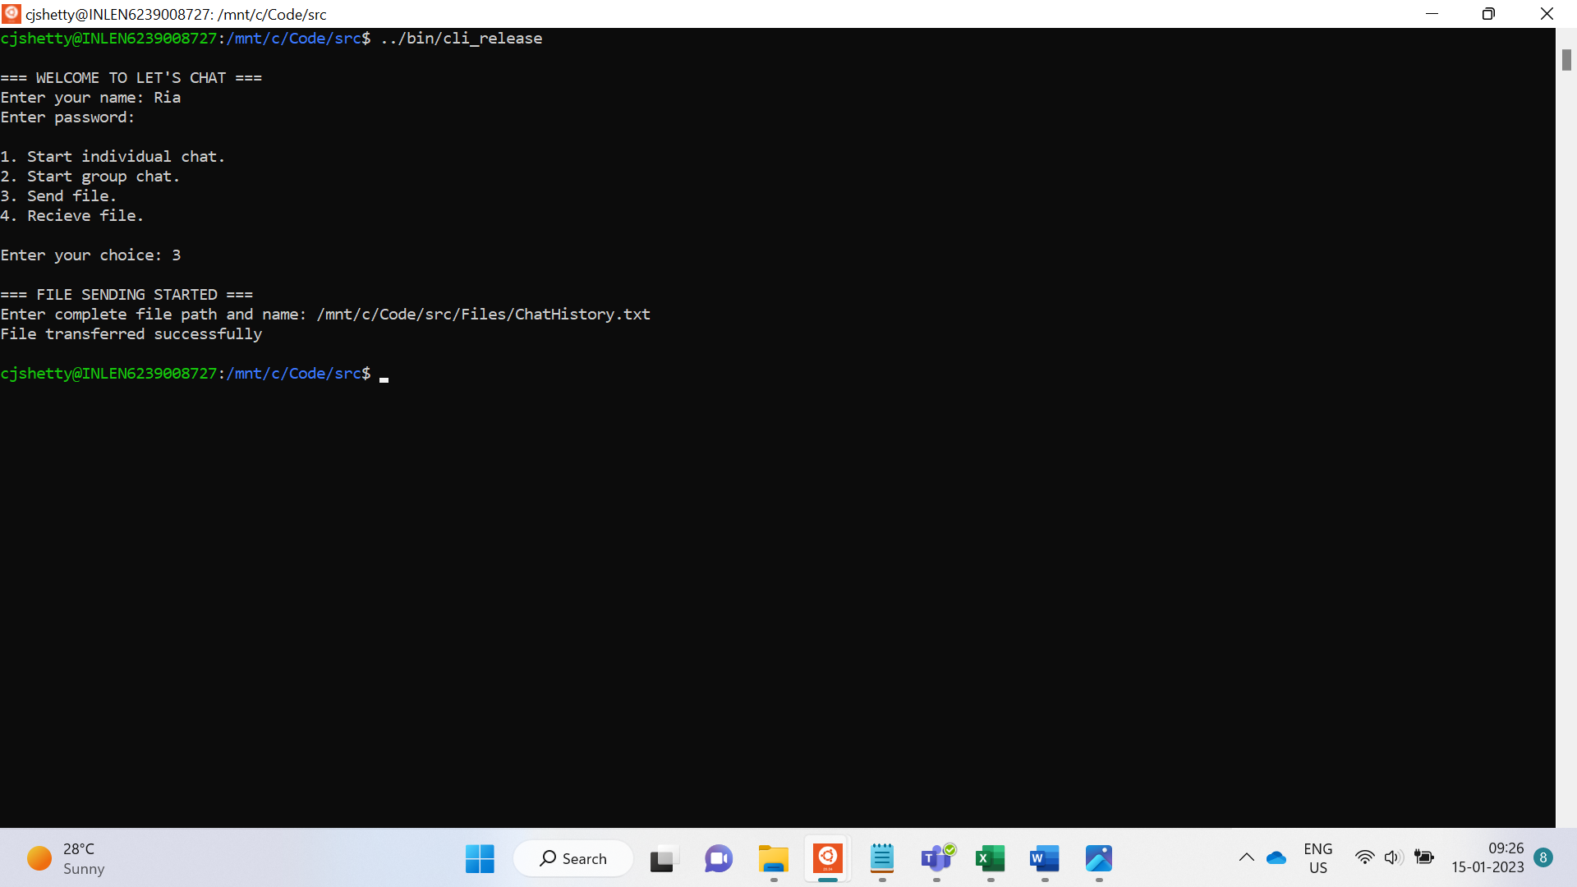
3. Send Files

Slide 13
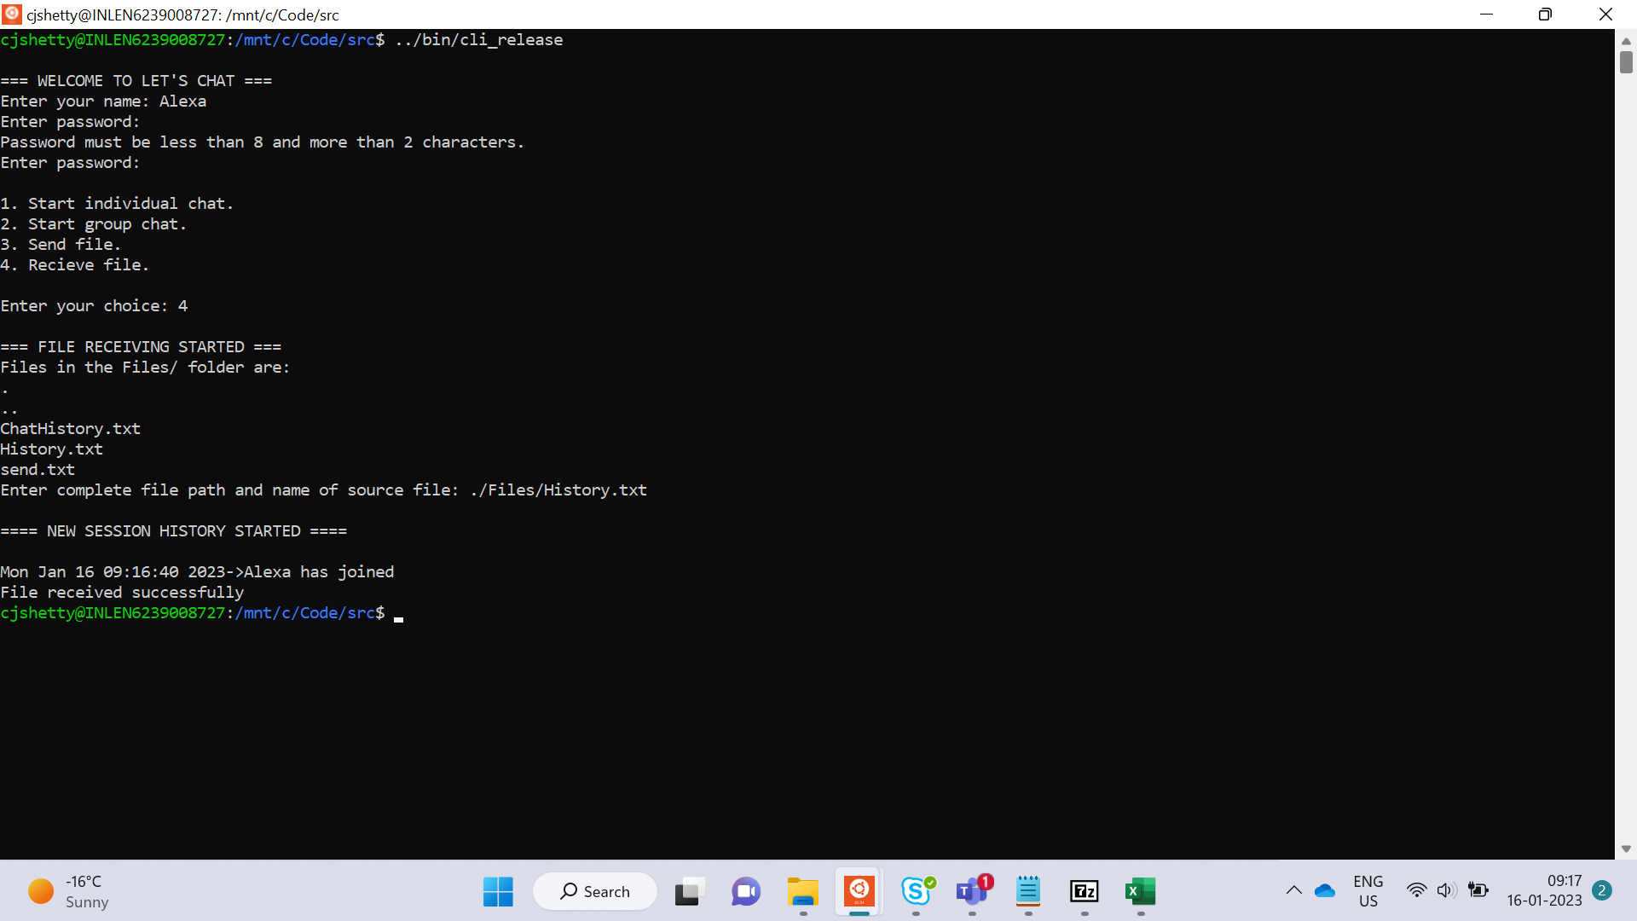
4. Receive Files

Slide 14
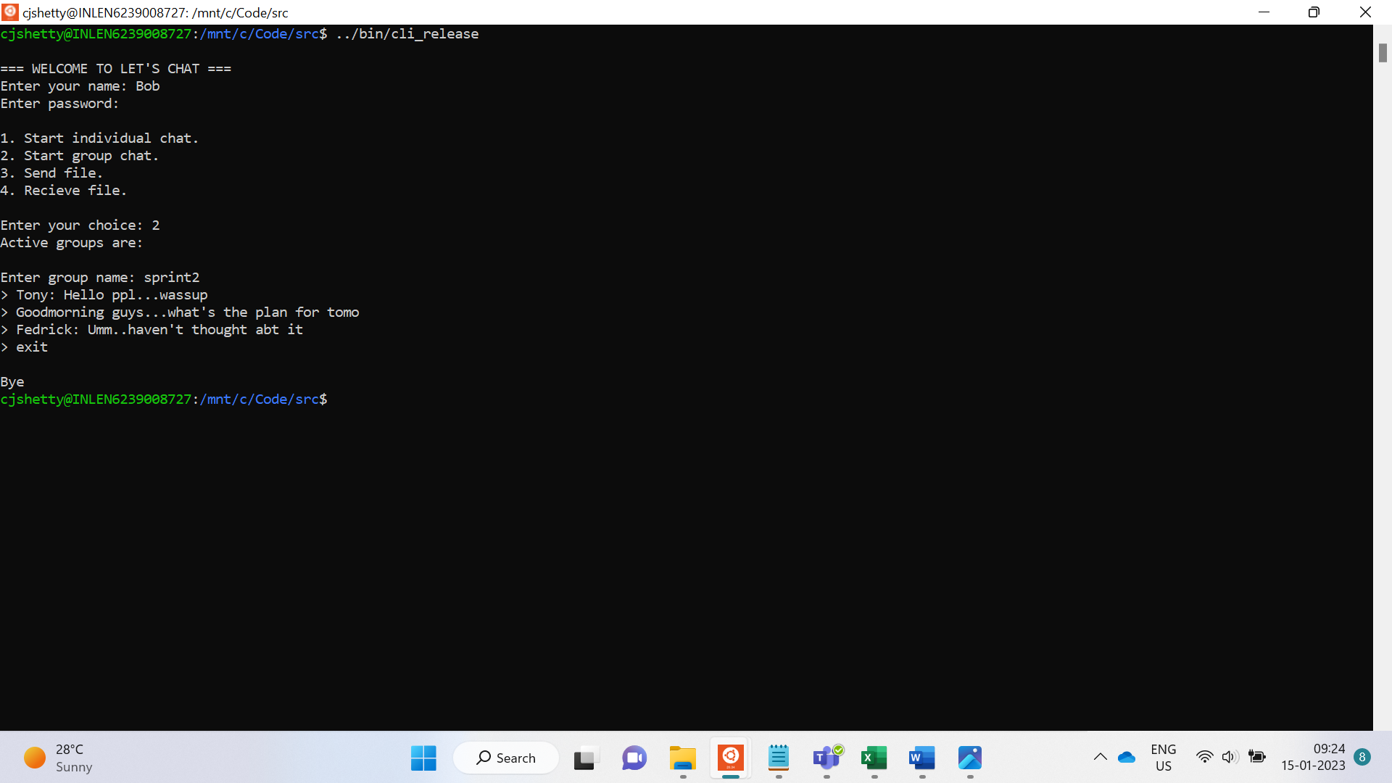
5. Exit from Application

Slide 15
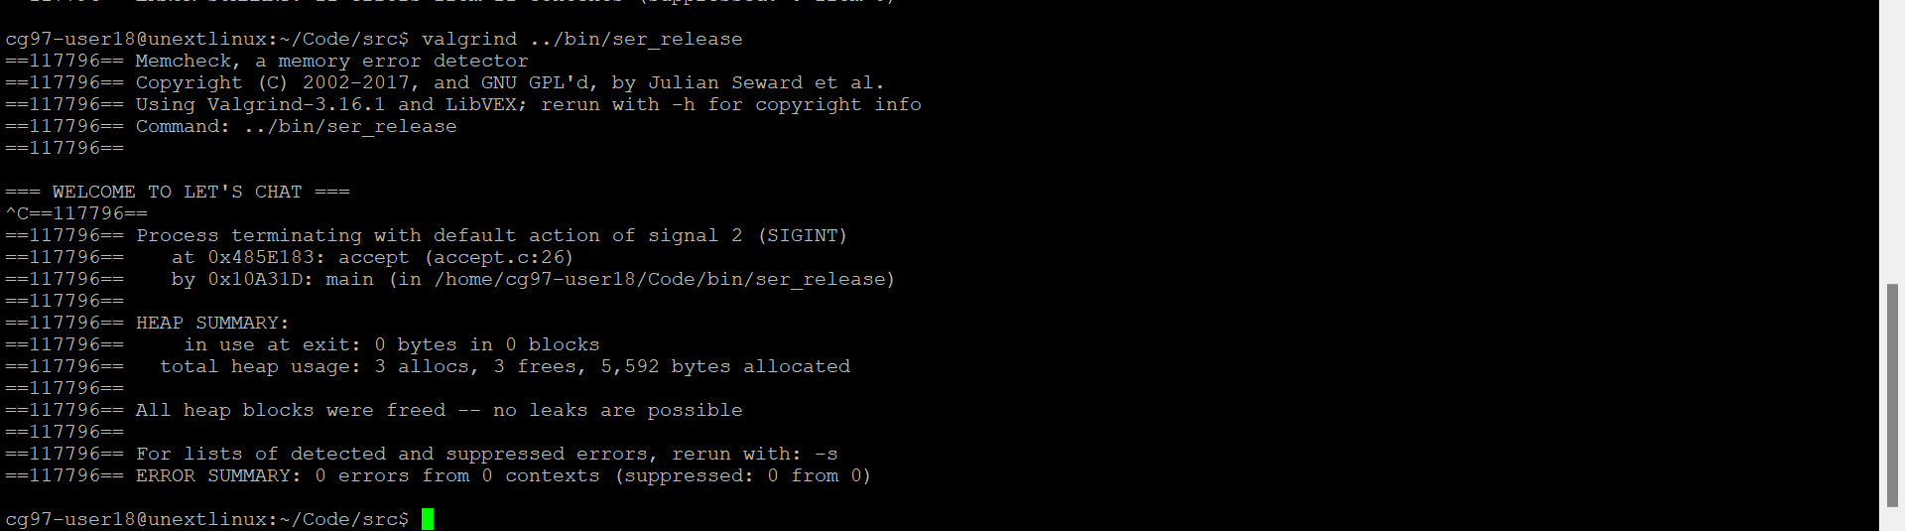
Valgrind Tool Report

Slide 16
THANK YOU

